Slide 1
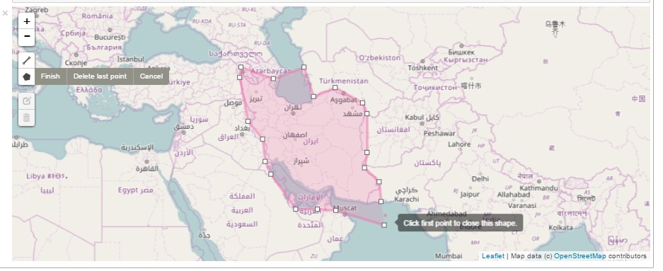
Google Shade--Track Where You’ve Been
Coder: Justin Marr
I am using for practice a repository, ipyleaflet, by github user ellisonbg. Not sure if I will end up using anything from this on my final presentation.

